Slide 1
組合語言程式開發

Slide 2
為什麼要用組合語言開發程式?

Slide 3
指令(instruction)
Assembled into machine code by assembler
Executed at runtime by the CPU
We use the Intel IA-32 instruction set
Instruction 格式
Label
(optional)
Mnemonic
(required)
Operand
(depends on
the instruction)
;Comment
(optional)
stc ; set Carry flag
stc
; set Carry flag
inc eax ; register
inc
eax
; register
add ebx,ecx ; register, register
add
ebx,ecx
; register, register

Slide 4
指令(instruction)
Intel IA-32 instruction set
Instruction 格式
Label
(optional)
Mnemonic
(required)
Operand
(depends on
the instruction)
;Comment
(optional)
Act as place markers
marks the address (offset) of code and data
Follow identifer rules
Data label
must be unique
example: myArray (not followed by colon)
Code label
target of jump and loop instructions
example: L1: (followed by colon)
Instruction Mnemonics
memory aid
examples: MOV, ADD, SUB, MUL, INC, DEC
Operands
constant
constant expression
register
memory (data label)
Constants and constant expressions are often called immediate values

Slide 5
Assembler Directives
組譯器{指引|虛擬指令}
are recognized and acted upon by the assembler
嵌入在程式碼中的命令，此類命令由組譯器加以辨識與使用
Not part of the Intel instruction set
不是Intel 指令集
Used to declare code, data areas, select memory model, declare procedures, etc.
定義程式區段(segment)
Not case sensitive!不區分大小寫
Different assemblers have different directives
NASM not the same as MASM
MASM
Directive重要功能➔定義程式區段(segment) 。區段是有著不同功能!
區段 | 功能
.DATA .data | 程式中含有變數的區域
.code | 程式中含有可以執行的指令區域
.STACK | 程式在執行階段，保存堆疊的區域，並且設定其大小
https://msdn.microsoft.com/en-us/library/8t163bt0.aspx

Slide 6
指令(instruction)vs虛擬指令(Directive)
Assembler Directives 組譯器{指引|虛擬指令}
Data label
虛擬指令(Directive)
myVar
DWORD
16
告訴組譯器，在程式中為一個雙字組變數保留空間
變數
指令(instruction) 是一個或多個組合語言程式經過組譯以後，可以執行的敘述。
指令會由組譯器翻譯成機器語言位元組;這些機器語言會在執行時期，被CPU 載入及執行
mov
eax, myVar
MOV 指令會在執行階段時把myVar的內容複製到EAX暫存器內
指令(instruction)
所有Intel 處理器的組譯器使用相同指令集
但不同Assembler使用的虛擬指令(Directive)卻是不同
Microsoft 組譯器的REPT 虛擬指令，在其他組譯器中，就無法辨識。

Slide 7



組合語言與組譯器
https://en.wikipedia.org/wiki/Comparison_of_assemblers
Flat Assembler (FASM)
GNU Assembler (GAS)
High Level Assembly (HLA)
Turbo Assembler (TASM)
Open Watcom Assembler (WASM) Yasm
MASM
Microsoft Macro Assembler
Intel IA-32 instruction set

Slide 8
Microsoft MASM

Slide 9
Ch3
AddTwoSum.asm
32位元MASM
64位元MASM
; AddTwoSum.asm - Chapter 3 example.
.386
.model flat,stdcall
.stack 4096
ExitProcess proto, dwExitCode:dword
.data
sum dword 0
.code
main proc
mov eax,5 add eax,6
mov sum,eax
invoke ExitProcess,0
main endp
end main
; AddTwoSum_64.asm - Chapter 3 example.
ExitProcess proto
.data
sum qword 0
.code
main proc
mov rax,5
add rax,6
mov sum,rax
mov ecx,0
call ExitProcess
main endp
end
MASM supports 64-bit programming, although the following directives are not permitted:
INVOKE, ADDR, .model, .386, .stack

Slide 10
Ch3
AddTwoSum.asm
註解Comments
; AddTwoSum.asm - Chapter 3 example.
.386
.model flat, stdcall
.stack 4096
ExitProcess proto, dwExitCode:dword
.data
sum dword 0
.code
main proc
mov eax,5 add eax,6
mov sum,eax
invoke ExitProcess,0
main endp
end main
區段 | 功能
.386 | 這是一個32 位元程式，可以存取32 位元暫存器與位址。
.model | 告知組譯器使用哪個記憶體模式 program’s memory model (flat) 使用哪個calling convention (stdcall)
.stack | Runtime stack大小 程式在執行階段保存堆疊的區域，及其大小(bytes)
.data | 程式中含有變數的區域
.code | 程式中含有可以執行的指令區域
http://www.plantation-productions.com/Webster/www.artofasm.com/DOS/pdf/ch08.pdf

Slide 11
Ch3
AddTwoSum.asm
註解Comments
; AddTwoSum.asm - Chapter 3 example.
.386
.model flat, stdcall
.stack 4096
ExitProcess proto, dwExitCode:dword
.data
sum dword 0
.code
main proc
mov eax,5 add eax,6
mov sum,eax
invoke ExitProcess,0
main endp
end main
第一個指令執行的位置
程式入口點
MASM Directives | 功能
proc | 程序的開端
endp | 程序的結尾
end虛擬指令標記程式的結尾，並參照程式入口點!
在end虛擬指令後所有程式、註解都會被組譯器忽略!

Slide 12
Ch3
AddTwoSum.asm
註解 Comments
; AddTwoSum.asm - Chapter 3 example.
.386
.model flat, stdcall
.stack 4096
ExitProcess proto, dwExitCode:dword
.data
sum dword 0
.code
main proc
mov eax,5 add eax,6
mov sum,eax
invoke ExitProcess,0
main endp
end main
函數原型宣告
prototype
ExitProcess | 函數名稱
proto | Keyword關鍵字 defines a prototype for a procedure
dwExitCode: dword | input parameter 輸入參數 回傳給windows作業系統的值 O代表成功 任何其他的整數值代表錯誤
When your program is ready to finish, it
calls ExitProcess and returns an integer that tells the operating system that your program
worked just fine

Slide 13
Ch8.4.6
swap.asm
; Swap Procedure Example
INCLUDE Irvine32.inc
Swap PROTO, ; procedure prototype
pValX:PTR DWORD,
pValY:PTR DWORD
.data
Array DWORD 10000h,20000h
.code
main PROC
; Display the array before the exchange:
mov esi,OFFSET Array
mov ecx,2 ; count = 2
mov ebx,TYPE Array
call DumpMem ; dump the array values
INVOKE Swap,ADDR Array, ADDR [Array+4]
; Display the array after the exchange:
call DumpMem
Exit
main ENDP
Swap PROC USES eax esi edi,
pValX:PTR DWORD, ; pointer to first integer
pValY:PTR DWORD ; pointer to second integer
;
; Exchange the values of two 32-bit integers
; Returns: nothing
;-------------------------------------------------------
mov esi,pValX ; get pointers
mov edi,pValY
mov eax,[esi] ; get first integer
xchg eax,[edi] ; exchange with second
mov [esi],eax ; replace first integer
ret
Swap ENDP
END main

Slide 14

http://kipirvine.com/asm/

Slide 15

CH01 基本概念
CH02 x86處理器架構
CH03 組合語言基礎
CH04 資料轉移、定址和算術
CH05 程序
CH06 條件處理
CH07 整數算術運算
CH08 進階程序
CH09 字串與陣列
CH10 結構與巨集
CH11 微軟視窗程式設計
CH12 浮點運算處理與指令編碼
CH13 高階語言介面
附錄A MASM參考資料
附錄B x86指令集

Slide 16
NASM
assembly language

Slide 17

nasm@64-bit kali Linux 2017.1
Netwide Assembler (NASM)
usage: nasm [-@ response file] [-o outfile] [-f format] [-l listfile]
[options...] [--] filename
or nasm -v (or --v) for version info
-t assemble in SciTech TASM compatible mode
-E (or -e) preprocess only (writes output to stdout by default)
-a don't preprocess (assemble only)
-M generate Makefile dependencies on stdout
-MG d:o, missing files assumed generated
-MF <file> set Makefile dependency file
-MD <file> assemble and generate dependencies
-MT <file> dependency target name
-MQ <file> dependency target name (quoted)
-MP emit phony target
-Z<file> redirect error messages to file
-s redirect error messages to stdout
-g generate debugging information
-F format select a debugging format
-gformat same as -g -F format
-o outfile write output to an outfile
-f format select an output format
-l listfile write listing to a listfile
-I<path> adds a pathname to the include file path
-O<digit> optimize branch offsets
-O0: No optimization
-O1: Minimal optimization
-Ox: Multipass optimization (default)
-P<file> pre-includes a file
-D<macro>[=<value>] pre-defines a macro
-U<macro> undefines a macro
-X<format> specifies error reporting format (gnu or vc)
-w+foo enables warning foo (equiv. -Wfoo)
-w-foo disable warning foo (equiv. -Wno-foo)
-h show invocation summary and exit
…………………………………………………………………………………………..
For a list of valid output formats, use -hf.
For a list of debug formats, use -f <form> -y.
The Netwide Assembler (NASM) is an assembler and disassembler for the Intel x86 architecture.
It can be used to write 16-bit, 32-bit (IA-32) and 64-bit (x86-64) programs.
NASM is considered to be one of the most popular assemblers for Linux.
NASM was originally written by Simon Tatham with assistance from Julian Hall.
As of 2016, it is maintained by a small team led by H. Peter Anvin.
It is open-source software released under the terms of a simplified (2-clause) BSD license.
nasm -h | 列出各種參數
nasm -v | NASM version 2.12.01 版本
nasm@32-bit kali Linux 2017.1
https://en.wikipedia.org/wiki/Netwide_Assembler

Slide 18
nasm程式執行
1
程式碼撰寫
gedit
Vim
副檔名: XXX.asm
2
程式碼組譯
$ nasm -f elf64 hello-world.asm
➔產生
hello-world.o
$ nasm -f elf32 hello-world.asm
3
連結
$ ld hello-world.o -o hello-world
4
程式執行
$ ./hello-world
➔產生hello-world執行檔
本次上課環境: Kali Linux 2017.1(32 bits)

Slide 19
nasm程式碼架構 由不同section組成,各section有不同功能
section .data
; Section containing initialised data《有初值的資料》
section .bss
; Section containing uninitialized data《沒有初值的資料》
;可有可無的選項
section .text
; Section containing code 《執行程式碼》
http://www.posix.nl/linuxassembly/nasmdochtml/nasmdoca.html
http://athena.nitc.ac.in/piyush_b130057cs/NASM/NASM%20TUTORIAL.pdf

Slide 20
http://rextester.com/l/nasm_online_compiler
32
;nasm 2.11.08
section .data
hello: db 'Hello world!',10 ; 'Hello world!' plus a linefeed character
helloLen: equ $-hello ; Length of the 'Hello world!' string
section .text
global _start
_start:
mov eax,4 ; The system call for write (sys_write)
mov ebx,1 ; File descriptor 1 - standard output
mov ecx,hello ; Put the offset of hello in ecx
mov edx,helloLen ; helloLen is a constant, so we don't need to say
; mov edx,[helloLen] to get it's actual value
int 80h ; Call the kernel
mov eax,1 ; The system call for exit (sys_exit)
mov ebx,0 ; Exit with return code of 0 (no error)
int 80h;

Slide 21
http://rextester.com/l/nasm_online_compiler
32
;nasm 2.11.08
section .data
hello: db 'Hello world!',10 ; 'Hello world!' plus a linefeed character
helloLen: equ $-hello ; Length of the 'Hello world!' string
section .text
global _start
_start:
mov eax,4 ; The system call for write (sys_write)
mov ebx,1 ; File descriptor 1 - standard output
mov ecx,hello ; Put the offset of hello in ecx
mov edx,helloLen ; helloLen is a constant, so we don't need to say
; mov edx,[helloLen] to get it's actual value
int 80h ; Call the kernel
mov eax,1 ; The system call for exit (sys_exit)
mov ebx,0 ; Exit with return code of 0 (no error)
int 80h;

Slide 22
可以用hexdump看看 hd helloworld.o
00000000 7f 45 4c 46 01 01 01 00 00 00 00 00 00 00 00 00 |.ELF............|
00000010 01 00 03 00 01 00 00 00 00 00 00 00 00 00 00 00 |................|
00000020 40 00 00 00 00 00 00 00 34 00 00 00 00 00 28 00 |@.......4.....(.|
00000030 07 00 03 00 00 00 00 00 00 00 00 00 00 00 00 00 |................|
000000a0 70 01 00 00 22 00 00 00 00 00 00 00 00 00 00 00 |p..."...........|
000000b0 10 00 00 00 00 00 00 00 0d 00 00 00 03 00 00 00 |................|
000000c0 00 00 00 00 00 00 00 00 a0 01 00 00 31 00 00 00 |............1...|
000000d0 00 00 00 00 00 00 00 00 01 00 00 00 00 00 00 00 |................|
000000e0 17 00 00 00 02 00 00 00 00 00 00 00 00 00 00 00 |................|
000000f0 e0 01 00 00 70 00 00 00 05 00 00 00 06 00 00 00 |....p...........|
00000100 04 00 00 00 10 00 00 00 1f 00 00 00 03 00 00 00 |................|
00000110 00 00 00 00 00 00 00 00 50 02 00 00 26 00 00 00 |........P...&...|
00000120 00 00 00 00 00 00 00 00 01 00 00 00 00 00 00 00 |................|
00000150 04 00 00 00 08 00 00 00 00 00 00 00 00 00 00 00 |................|
00000160 48 65 6c 6c 6f 20 77 6f 72 6c 64 21 0a 00 00 00 |Hello world!....|
00000170 b8 04 00 00 00 bb 01 00 00 00 b9 00 00 00 00 ba |................|
00000180 0d 00 00 00 cd 80 b8 01 00 00 00 bb 00 00 00 00 |................|
00000190 cd 80 00 00 00 00 00 00 00 00 00 00 00 00 00 00 |................|
000001a0 00 2e 64 61 74 61 00 2e 74 65 78 74 00 2e 73 68 |..data..text..sh|
000001b0 73 74 72 74 61 62 00 2e 73 79 6d 74 61 62 00 2e |strtab..symtab..|
000001c0 73 74 72 74 61 62 00 2e 72 65 6c 2e 74 65 78 74 |strtab..rel.text|
000001d0 00 00 00 00 00 00 00 00 00 00 00 00 00 00 00 00 |................|
*
00000240 1f 00 00 00 00 00 00 00 00 00 00 00 10 00 02 00 |................|
00000250 00 68 65 6c 6c 6f 77 6f 72 6c 64 2e 61 73 6d 00 |.helloworld.asm.|
00000260 68 65 6c 6c 6f 00 68 65 6c 6c 6f 4c 65 6e 00 5f |hello.helloLen._|
00000270 73 74 61 72 74 00 00 00 00 00 00 00 00 00 00 00 |start...........|
00000280 0b 00 00 00 01 02 00 00 00 00 00 00 00 00 00 00 |................|
00000290
執行步驟
$ nasm -f elf32 helloworld.asm
$ ld helloworld.o -o helloworld
$ ./hello-world
摘圖

Slide 23
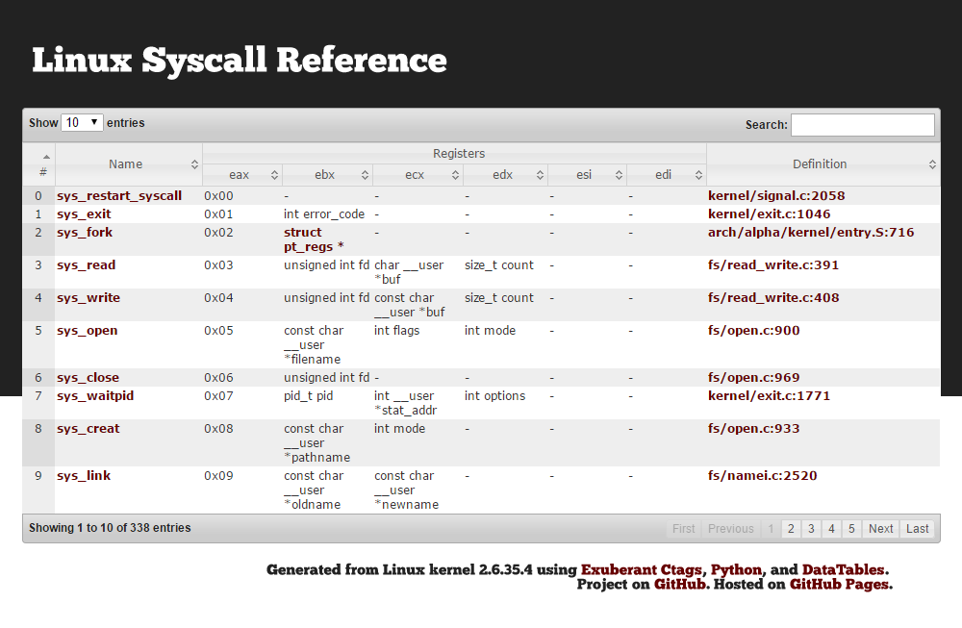
32位元Linux系統呼叫 http://syscalls.kernelgrok.com/

Slide 24
nasm -f elf32 helloworld.asm -o test.o -l test
1 ;nasm 2.11.08
2
3 section .data
4 00000000 48656C6C6F20776F72- hello: db 'Hello world!',10 ; 'Hello world!' plus a linefeed character
4 00000009 6C64210A
5 helloLen: equ $-hello ; Length of the 'Hello world!' string
6
7 section .text
8 global _start
9
10 _start:
11 00000000 B804000000 mov eax,4 ; The system call for write (sys_write)
12 00000005 BB01000000 mov ebx,1 ; File descriptor 1 - standard output
13 0000000A B9[00000000] mov ecx,hello ; Put the offset of hello in ecx
14 0000000F BA0D000000 mov edx,helloLen ; helloLen is a constant, so we don't need to say
15 ; mov edx,[helloLen] to get it's actual value
16 00000014 CD80 int 80h ; Call the kernel
17
18 00000016 B801000000 mov eax,1 ; The system call for exit (sys_exit)
19 0000001B BB00000000 mov ebx,0 ; Exit with return code of 0 (no error)
20 00000020 CD80 int 80h;
21

Slide 25
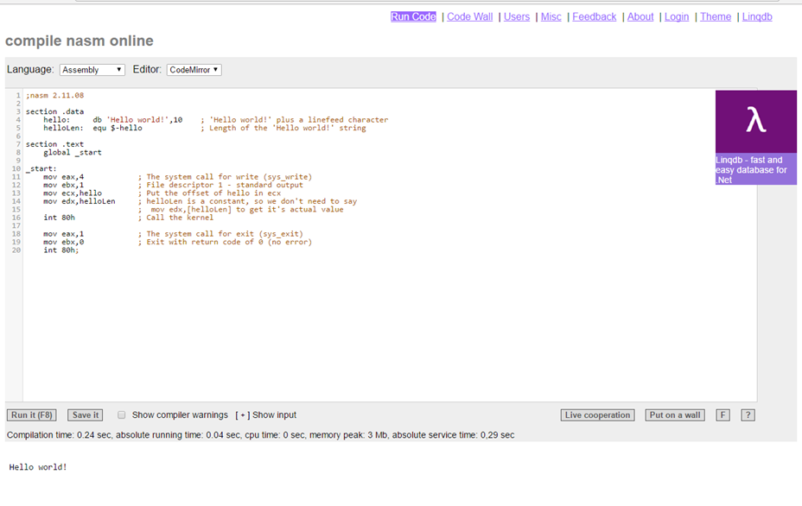
使用線上組譯器
http://rextester.com/l/nasm_online_compiler
Ａ
①程式碼寫在此
Ｂ
②執行結果

Slide 26
64位元NASM 組合程式
64-bit x64

Slide 27
64
; 64-bit "Hello World!" in Linux NASM
global _start ; global entry point export for ld
section .text
_start:
; sys_write(stdout, message, length)
mov rax, 1 ; sys_write
mov rdi, 1 ; stdout
mov rsi, message ; message address
mov rdx, length ; message string length
syscall
; sys_exit(return_code)
mov rax, 60 ; sys_exit
mov rdi, 0 ; return 0 (success)
syscall
section .data
message: db 'Hello, world!',0x0A ; message and newline
length: equ $-message ; NASM definition pseudo-instruction
系統呼叫
系統呼叫

Slide 28
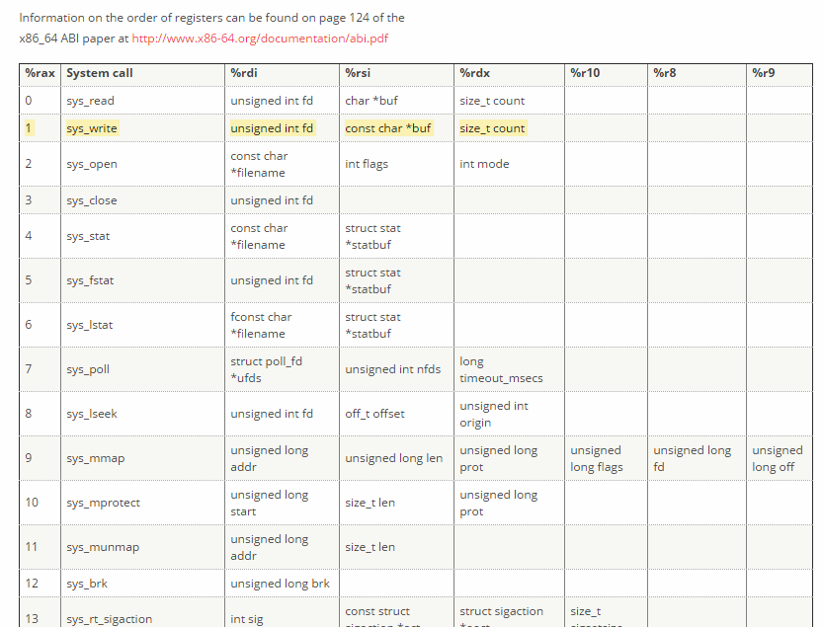
64位元Linux系統呼叫[1/60] http://blog.rchapman.org/posts/Linux_System_Call_Table_for_x86_64/

Slide 29
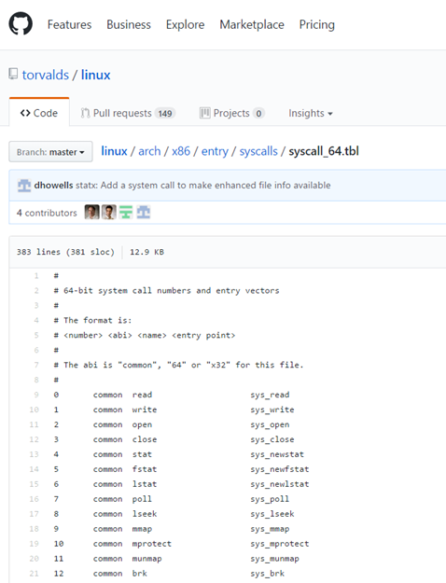

最新版的定義 https://github.com/torvalds/linux/blob/master/arch/x86/entry/syscalls/syscall_64.tbl

Slide 30
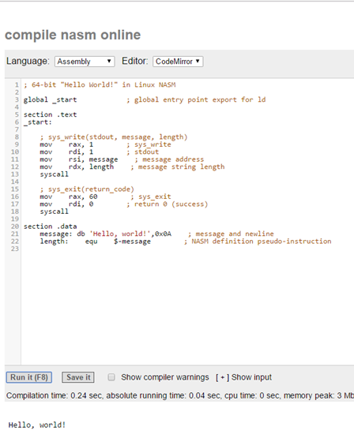
使用線上組譯器
http://rextester.com/l/nasm_online_compiler

Slide 31
; 64-bit "Hello World!" in Linux NASM
global _start ; global entry point export for ld
section .text
_start:
; sys_write(stdout, message, length)
mov rax, 1 ; sys_write
mov rdi, 1 ; stdout
mov rsi, message ; message address
mov rdx, length ; message string length
syscall
; sys_exit(return_code)
mov rax, 60 ; sys_exit
mov rdi, 0 ; return 0 (success)
syscall
section .data
message: db 'Hello, world!',0x0A ; message and newline
length: equ $-message ; NASM definition pseudo-instruction
;nasm 2.11.08
section .data
hello: db 'Hello world!',10
; 'Hello world!' plus a linefeed character
helloLen: equ $-hello ; Length of the 'Hello world!' string
section .text
global _start
_start:
mov eax,4 ; The system call for write (sys_write)
mov ebx,1 ; File descriptor 1 - standard output
mov ecx,hello ; Put the offset of hello in ecx
mov edx,helloLen
; helloLen is a constant, so we don't need to say
; mov edx,[helloLen] to get it's actual value
int 80h ; Call the kernel
mov eax,1 ; The system call for exit (sys_exit)
mov ebx,0 ; Exit with return code of 0 (no error)
int 80h;
32位元NASM組合語言
64位元NASM組合語言

Slide 32
作業

Slide 33
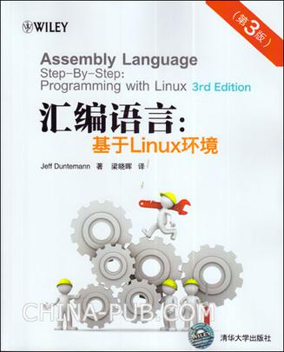
http://www.duntemann.com/assembly.html

Slide 34
目的:小寫轉成大寫
CH8
uppercaser2.asm
nasm -f elf -g -F stabs uppercaser2.asm;
ld -o uppercaser2 uppercaser2.o
echo asdmvd > test.txt
./uppercaser2 >test_upper.txt < test.txt
cat test_upper.txt
ASDMVD

Slide 35
CH8
uppercaser2.asm
SECTION .bss ; Section containing uninitialized data
BUFFLEN equ 1024 ; Length of buffer
Buff: resb BUFFLEN ; Text buffer itself
SECTION .data ; Section containing initialised data
SECTION .text ; Section containing code
global _start ; Linker needs this to find the entry point!
_start:
nop ; This no-op keeps gdb happy...

Slide 36
CH8
uppercaser2.asm
; Read a buffer full of text from stdin:
read:
mov eax,3 ; Specify sys_read call
mov ebx,0 ; Specify File Descriptor 0: Standard Input
mov ecx,Buff ; Pass offset of the buffer to read to
mov edx,BUFFLEN ; Pass number of bytes to read at one pass
int 80h ; Call sys_read to fill the buffer
mov esi,eax ; Copy sys_read return value for safekeeping
cmp eax,0 ; If eax=0, sys_read reached EOF on stdin
je Done ; Jump If Equal (to 0, from compare)
; Set up the registers for the process buffer step:
mov ecx,esi ; Place the number of bytes read into ecx
mov ebp,Buff ; Place address of buffer into ebp
dec ebp ; Adjust count to offset

Slide 37
CH8
uppercaser2.asm
; Go through the buffer and convert lowercase to uppercase characters:
Scan:
cmp byte [ebp+ecx],61h ; Test input char against lowercase 'a'
jb Next ; If below 'a' in ASCII, not lowercase
cmp byte [ebp+ecx],7Ah ; Test input char against lowercase 'z'
ja Next ; If above 'z' in ASCII, not lowercase ; At this point, we have a lowercase char
sub byte [ebp+ecx],20h ; Subtract 20h to give uppercase...
Next: dec ecx ; Decrement counter
jnz Scan
; If characters remain, loop back; Write the buffer full of processed text to stdout:
Write:
mov eax,4 ; Specify sys_write call
mov ebx,1 ; Specify File Descriptor 1: Standard output
mov ecx,Buff ; Pass offset of the buffer
mov edx,esi ; Pass the # of bytes of data in the buffer
int 80h ; Make kernel call
jmp read ; Loop back and load another buffer full
;All done!
Done:
mov eax,1 ; Code for Exit Syscall
mov ebx,0 ; Return a code of zero
int 80H ; Make kernel call

Slide 38
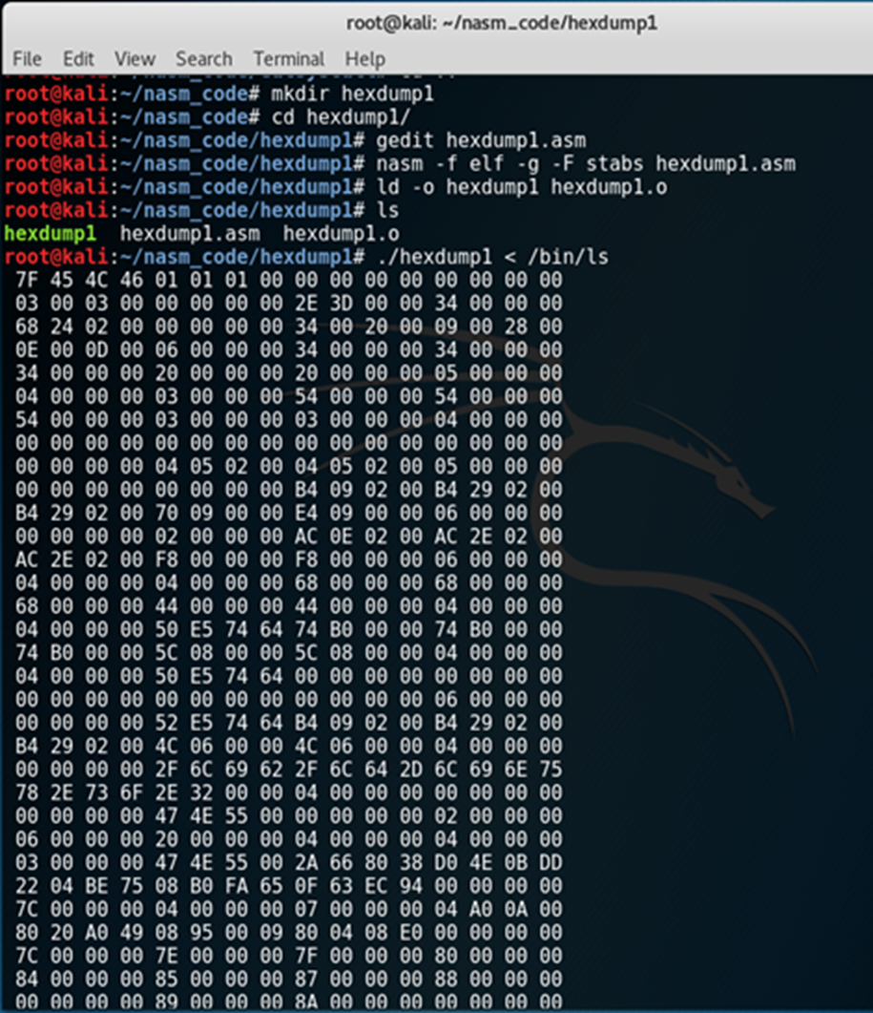
CH9
hexdump.asm
gedit hexdump1.asm
nasm -f elf -g -F stabs hexdump1.asm
ld -o hexdump1 hexdump1.o
./hexdump1 < /bin/ls

Slide 39
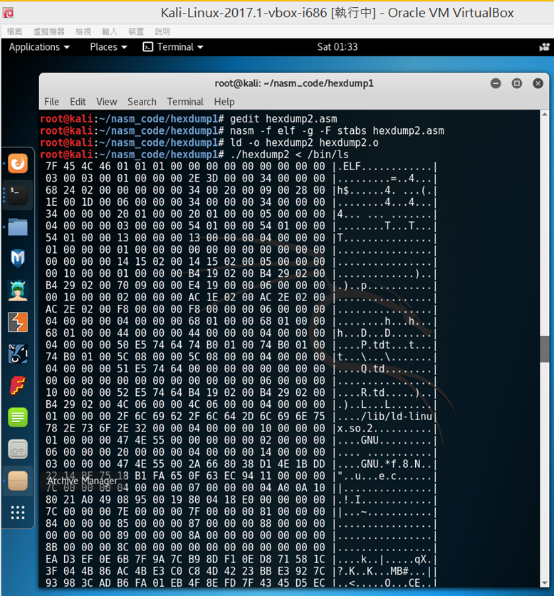
CH10
hexdump2.asm

Slide 40
Id常用指令
-static | 靜態連結
-l<libname> | 指定連結某個程式庫
-L <directory> | 指定連結時搜尋路徑，多個路徑之間用冒號隔聞
-e name | 指定name 為程式入口
-r | 合併目的檔，不進行最終連結
-M | 將連結時的符號和位址輸出成一個映射檔
-o | 指定輸出檔案名稱
-s | 清除輸出檔中的符號資訊
-S | 清除輸出檔中的除錯資訊
-T <scriptfile> | 指定連結腳本擋
-version-script <file> | 指定符號版本腳本檔
-soname <name> | 指定輸出共用程式庫的SONAME
-export-dynamic | 將全域符號全部匯出
-verbose | 連結時輸出詳細資訊
-rpath <path> | 指定連結時庫搜尋路徑

